Slide 2
JavaFX: Cross-Platform UI Development in Java
Johan Vos, @johanvos
Gluon, https://gluonhq.com

Slide 3
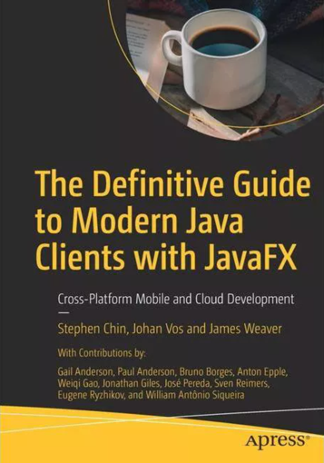
About me
Working with Java since 1995
Blackdown, Java to Linux
Co-lead of OpenJFX
Lead of OpenJDK Mobile
Java Champion
Co-author of “The Definitive Guide to Modern Java Clients with JavaFX”
Co-founder of Gluon
PhD physics, author of “Quantum Computing for (Java) developers”
Notes:
Maybe add a drawing on the next slide, showing how enterprise apps and web frontends communicate

Slide 4
About Gluon
A worldwide company by Java developers, for Java developers, enabling the Java Mobile Enterprise
JavaFX steward
OSS
OpenJFX, JavaFX 11+, maven/gradle plugins
SceneBuilder
Attach, Connect, Ignite, Maps
Main Products:
Gluon Mobile
Gluon CloudLink
Commercial support for JavaFX 11 LTS
Projects/consulting
Twitter @gluonhq, Web http://gluonhq.com
Notes:
Maybe add a drawing on the next slide, showing how enterprise apps and web frontends communicate

Slide 5
Agenda
What is JavaFX
Using JavaFX in IntelliJ IDEA
JavaFX ecosystem and development
JavaFX structure/architecture

Slide 6
Agenda
What is JavaFX
Using JavaFX in IntelliJ IDEA
JavaFX ecosystem and development
JavaFX structure/architecture

Slide 7
What is JavaFX
Java API’s for client development in general, and UI development in particular.
Developed under the OpenJDK umbrella, in the OpenJFX project, under the javafx namespace
javafx.application, javafx.scene, javafx.scene.control, javaf.scene.layout,…
Successor of AWT/Swing
Modern graphical toolkit, combining hardware acceleration and the Java advantages:
Secure
Mature
Performant
Large ecosystem
…

Slide 8
The stack
JavaFX apps
JavaFX Libraries etc
JavaFX Platform
Hardware/OS (desktop/mobile/embedded)

Slide 9
What is JavaFX
User Interface components, layout containers, controls
Core foundation for UI development
Java API’s, e.g. new Button(“Click me”)
FXML (declarative UI development)
Using Scene Builder
CSS styling

Slide 10
JavaFX and Java?
OpenJFX and OpenJDK have always been 2 separate projects (under the same umbrella)
Oracle JDK contained javafx jar in JDK 8 (in ext/ folder)
JavaFX has its own set of modules which can or can not be included in an SDK
JavaFX Platforms assumes it is loaded via a Module.
Recommended way: use maven/gradle plugins
See https://openjfx.io

Slide 11
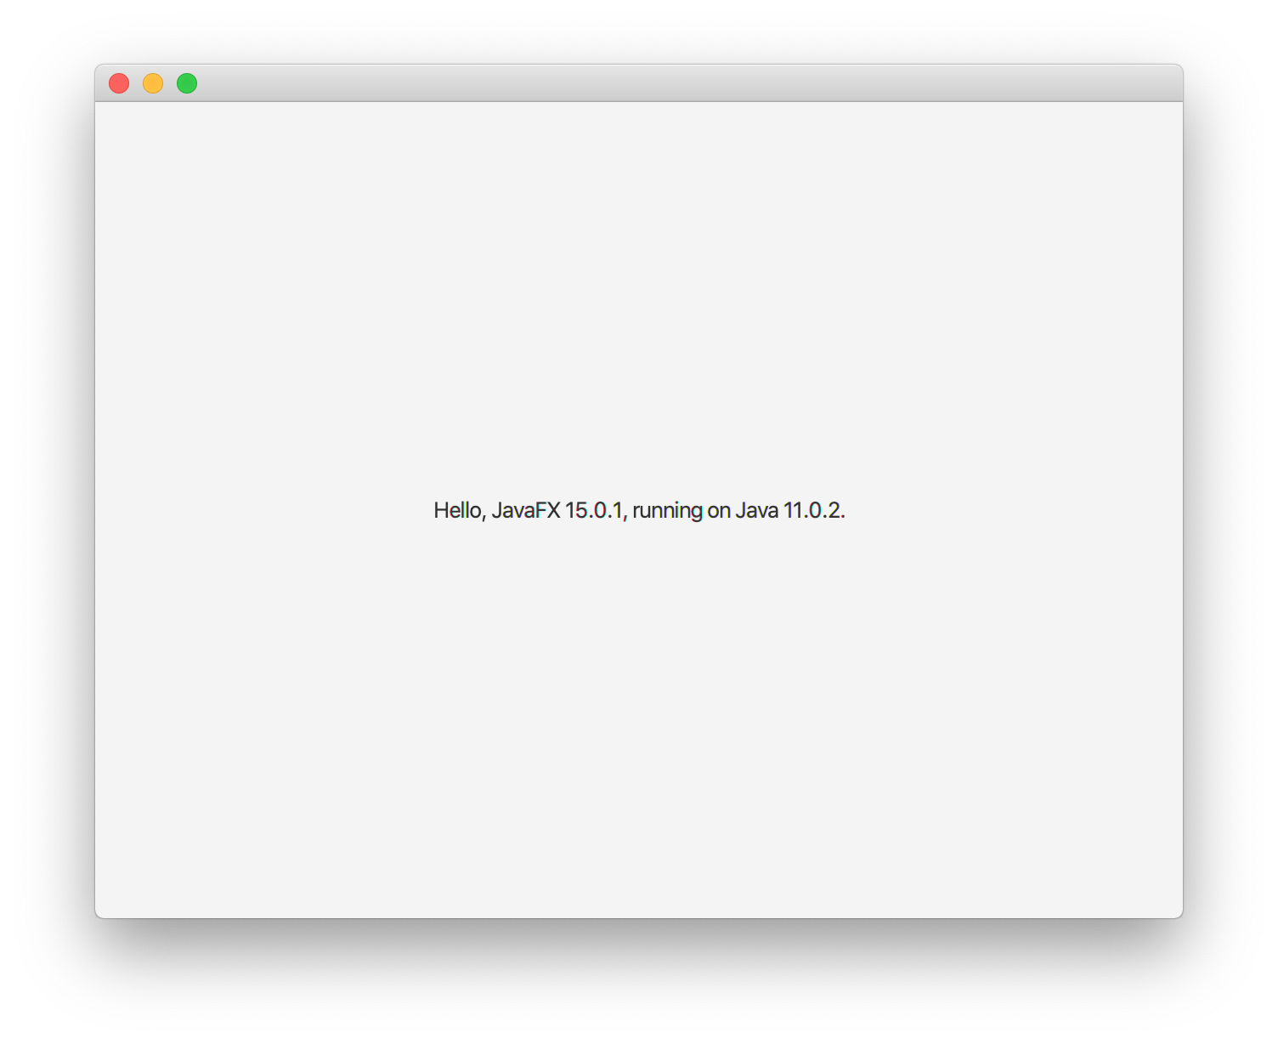
Hello, JavaFX
import javafx.application.Application;
import javafx.scene.Scene;
import javafx.scene.control.Label;
import javafx.scene.layout.StackPane;
import javafx.stage.Stage;
public class HelloFX extends Application {
@Override
public void start(Stage stage) {
String javaVersion = System.getProperty("java.version");
String javafxVersion = System.getProperty("javafx.version");
Label l = new Label("Hello, JavaFX " + javafxVersion + ", running on Java ”
+ javaVersion + ".");
Scene scene = new Scene(new StackPane(l), 640, 480);
stage.setScene(scene);
stage.show();
}
}

Slide 12
Agenda
What is JavaFX
Using JavaFX in IntelliJ IDEA
JavaFX ecosystem and development
JavaFX structure/architecture

Slide 13
Hello, JavaFX
import javafx.application.Application;
import javafx.scene.Scene;
import javafx.scene.control.Label;
import javafx.scene.layout.StackPane;
import javafx.stage.Stage;
public class HelloFX extends Application {
@Override
public void start(Stage stage) {
String javaVersion = System.getProperty("java.version");
String javafxVersion = System.getProperty("javafx.version");
Label l = new Label("Hello, JavaFX " + javafxVersion + ", running on Java ”
+ javaVersion + ".");
Scene scene = new Scene(new StackPane(l), 640, 480);
stage.setScene(scene);
stage.show();
}
}

Slide 14
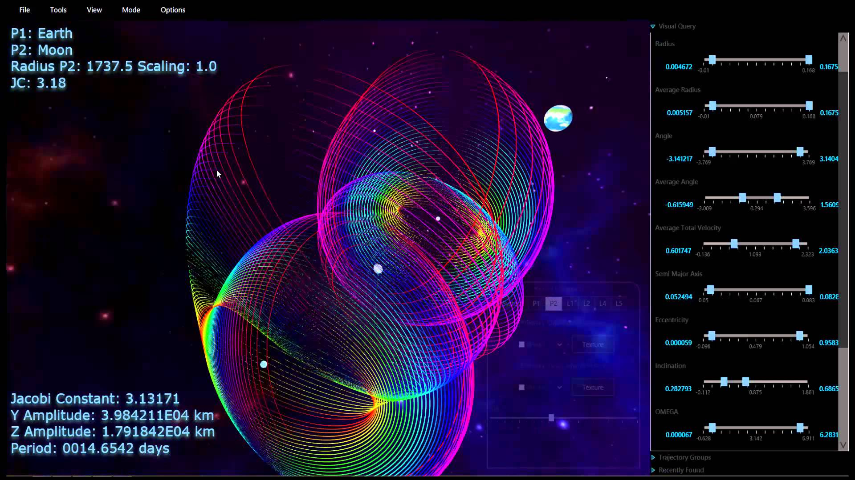
What can you do with JavaFX?
Deep space trajectory explorer
a.i. solutions

Slide 15
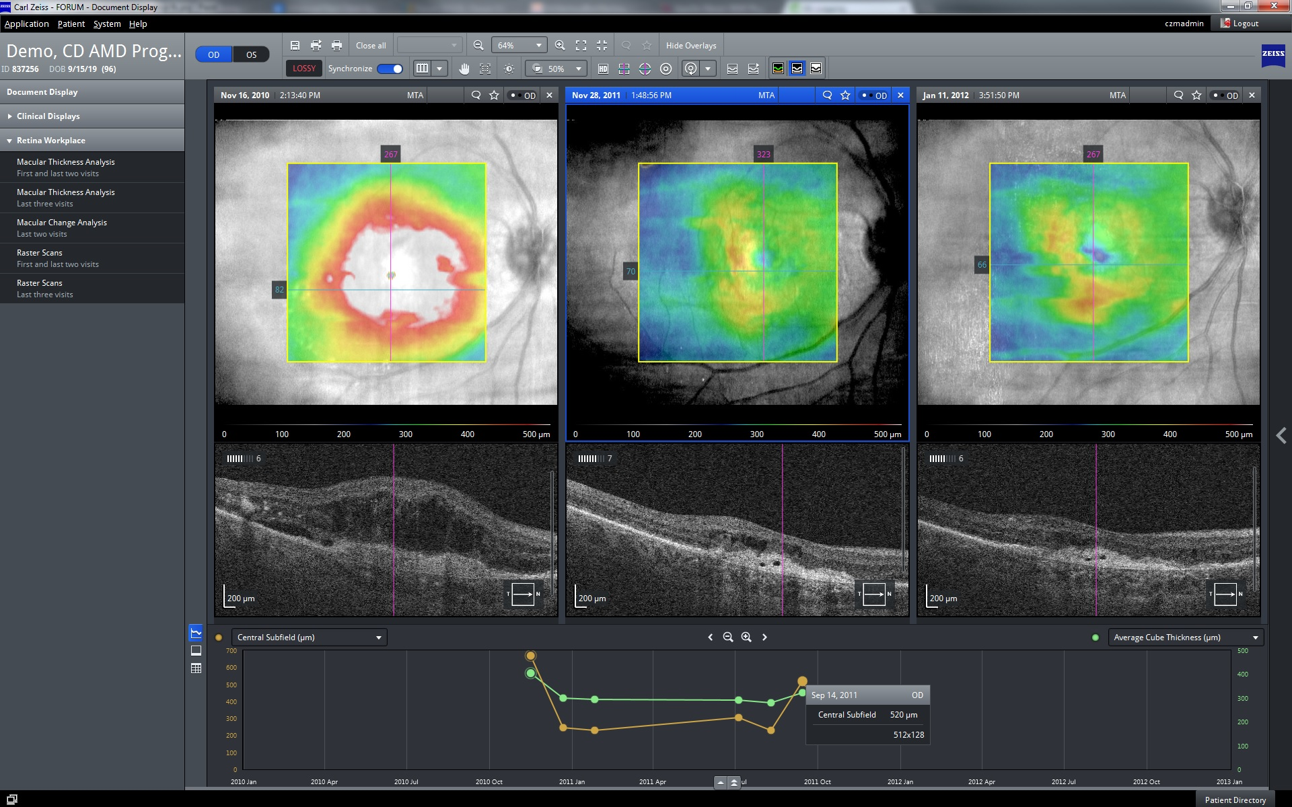
What can you do with JavaFX?
Carl Zeiss Meditec AG

Slide 16
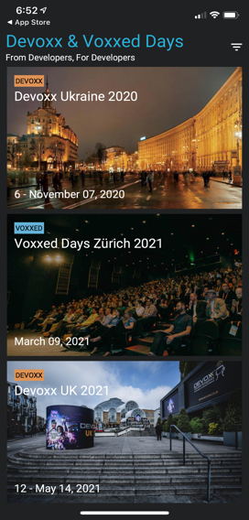
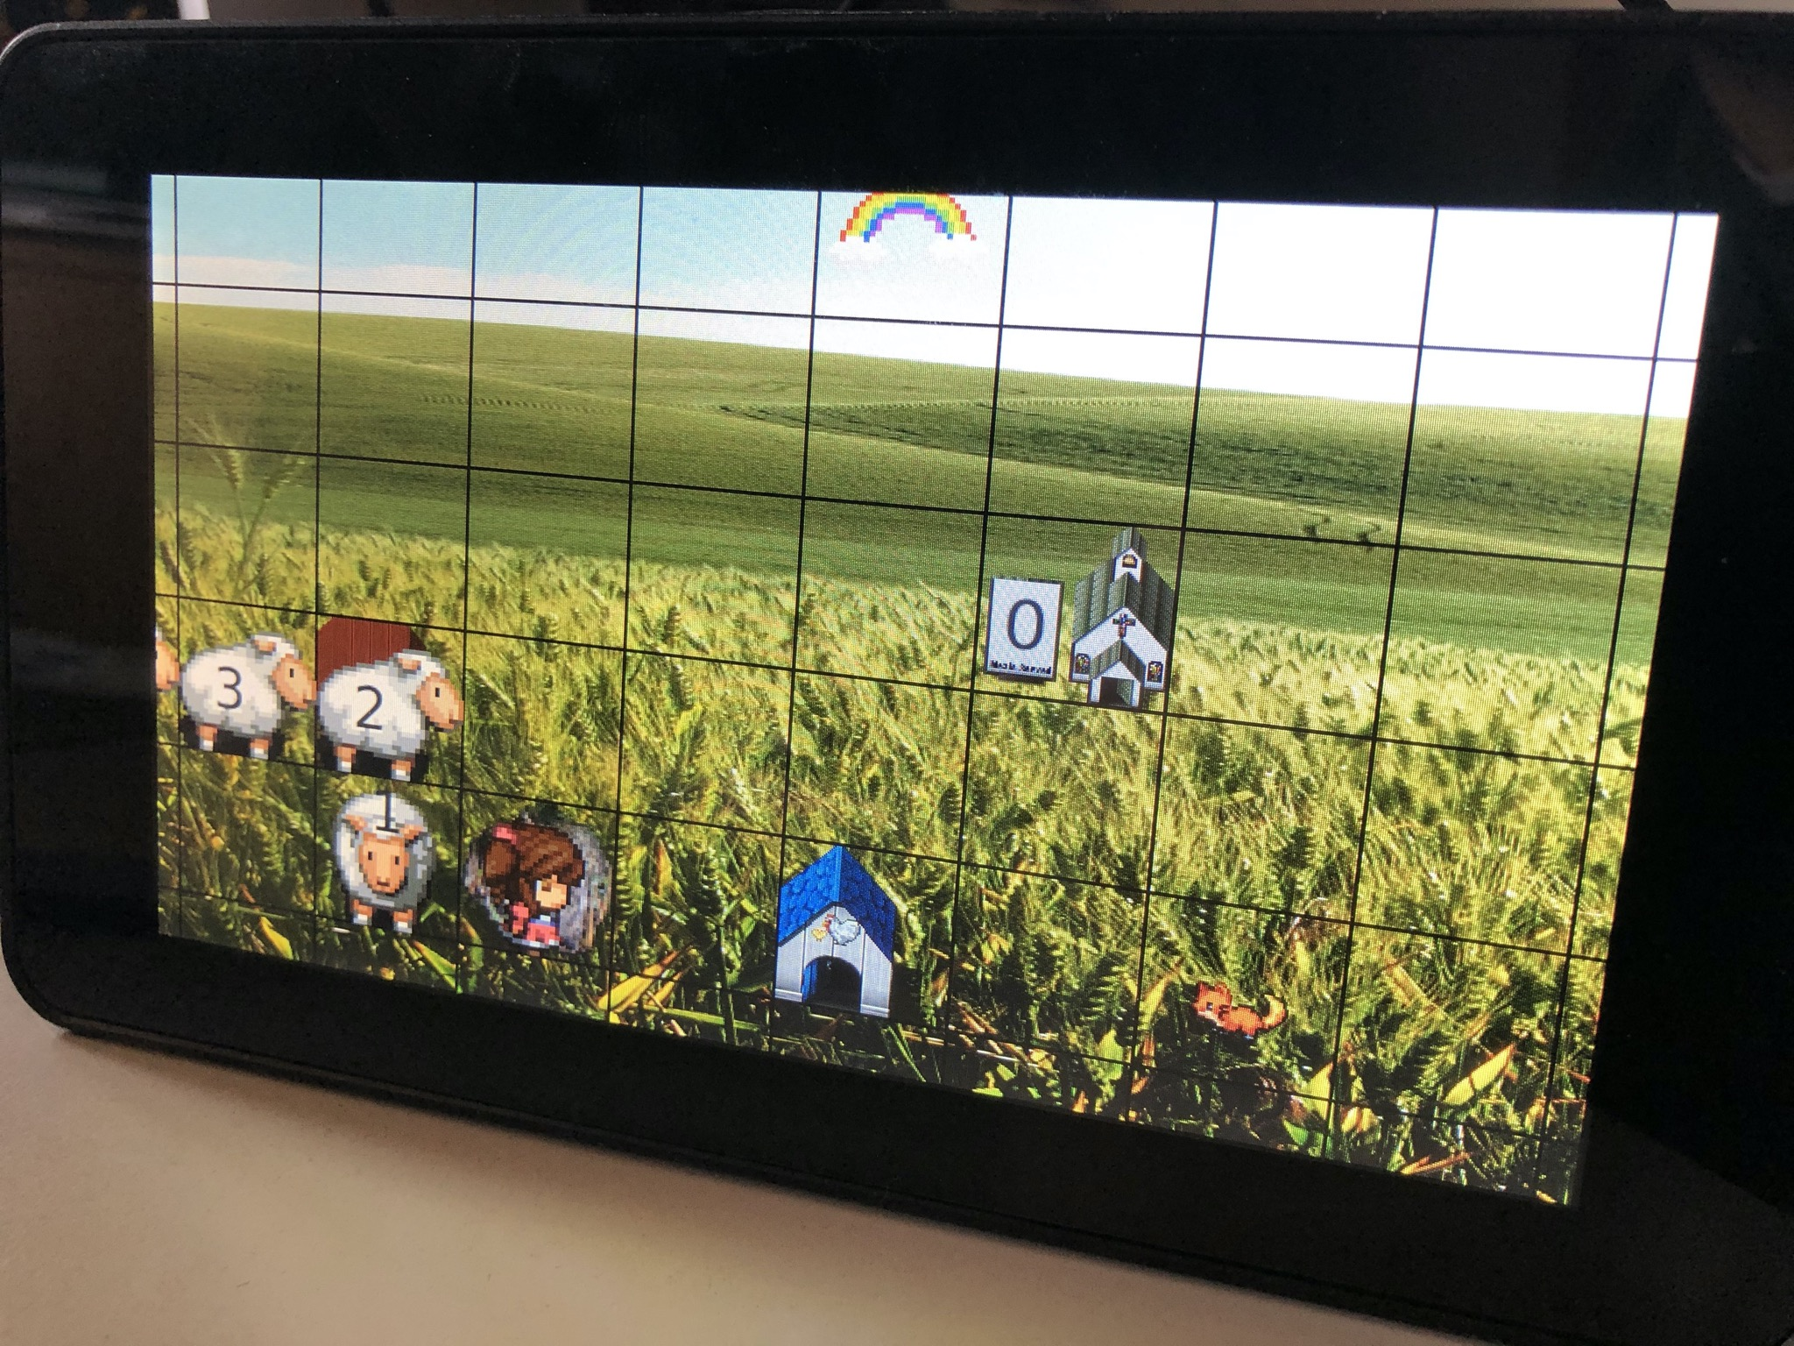
Beyond desktop

Slide 17
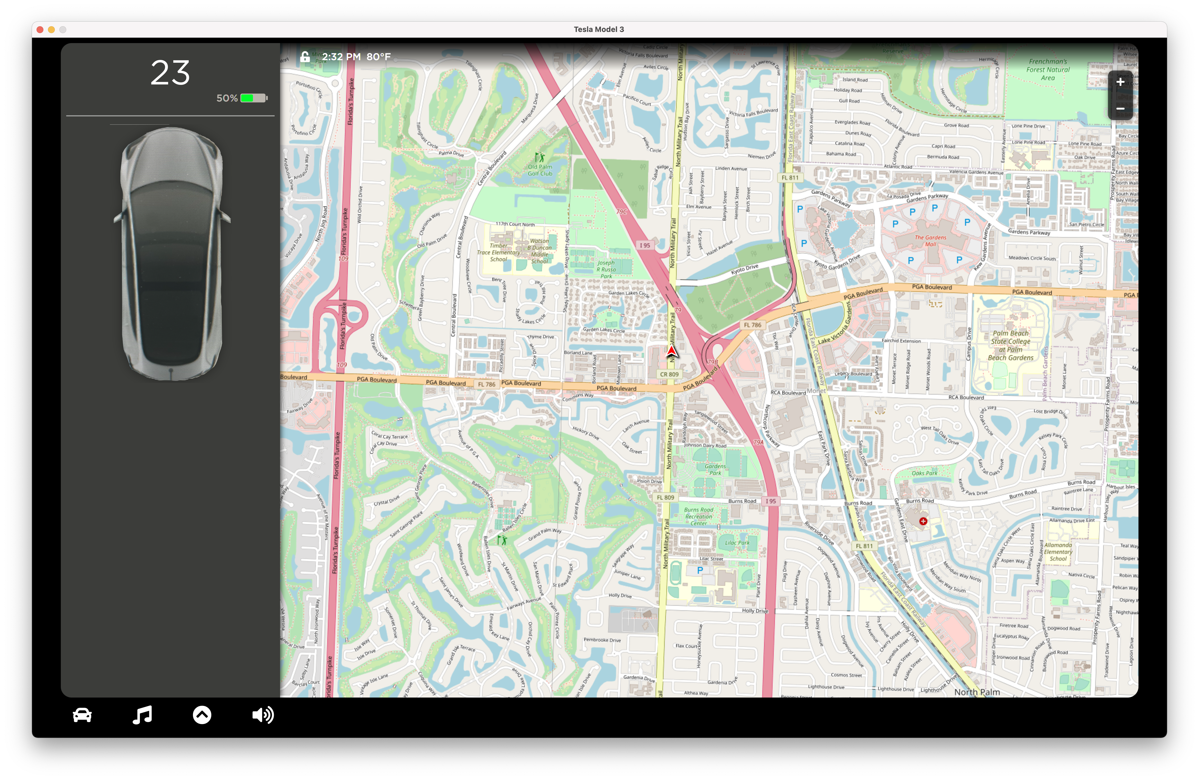

Slide 18
Agenda
What is JavaFX
Using JavaFX in IntelliJ IDEA
JavaFX ecosystem and development
JavaFX structure/architecture

Slide 19
The stack
JavaFX apps
JavaFX Libraries etc
JavaFX Platform
Hardware/OS (desktop/mobile/embedded)

Slide 20
The stack
JavaFX apps
JavaFX Libraries etc
JavaFX Platform
This is where we are
Hardware/OS (desktop/mobile/embedded)

Slide 21
The stack
JavaFX apps
JavaFX Libraries etc
Ecosystem
JavaFX Platform
Hardware/OS (desktop/mobile/embedded)

Slide 22
Ecosystem
JavaFX Application
Company employees, consultants (companies)
OSS libs
commercial libs
Companies, individuals
OpenJFX
(development + distribution)
Gluon, Oracle, individuals
1-2 devs: 900 USD/year
https://gluonhq.com/lts
Notes:
Maybe add a drawing on the next slide, showing how enterprise apps and web frontends communicate

Slide 23
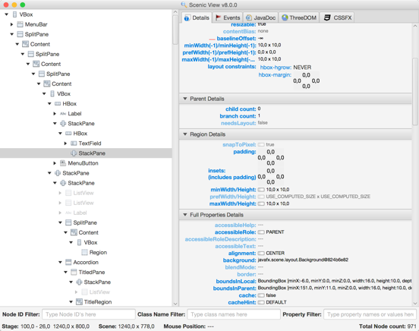
Tools
Scenic View
https://github.com/JonathanGiles/scenic-view/
SV 11 / 8 / 9
Notes:
Maybe add a drawing on the next slide, showing how enterprise apps and web frontends communicate

Slide 24
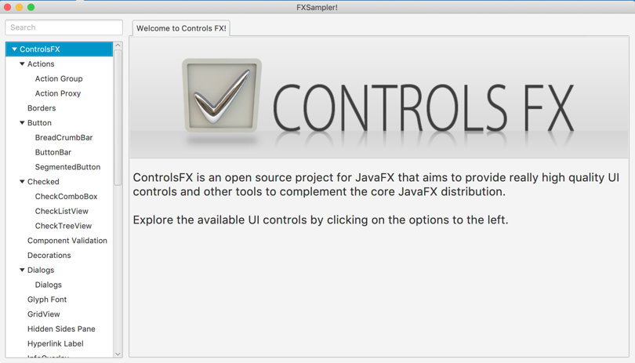
Community
ControlsFX
https://github.com/controlsfx/controlsfx/tree/9.0.0
8.40.15 / 11.0.0
Notes:
Maybe add a drawing on the next slide, showing how enterprise apps and web frontends communicate

Slide 25
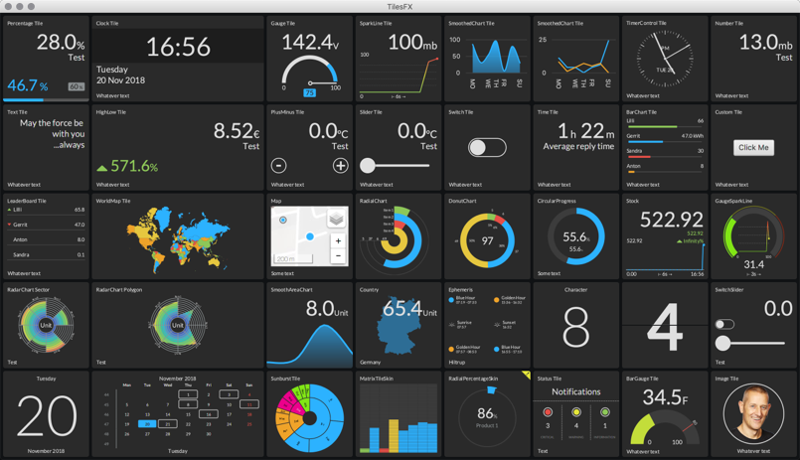
Community
TilesFX by Gerrit Grunwald
https://github.com/HanSolo/tilesfx
Notes:
Maybe add a drawing on the next slide, showing how enterprise apps and web frontends communicate

Slide 26
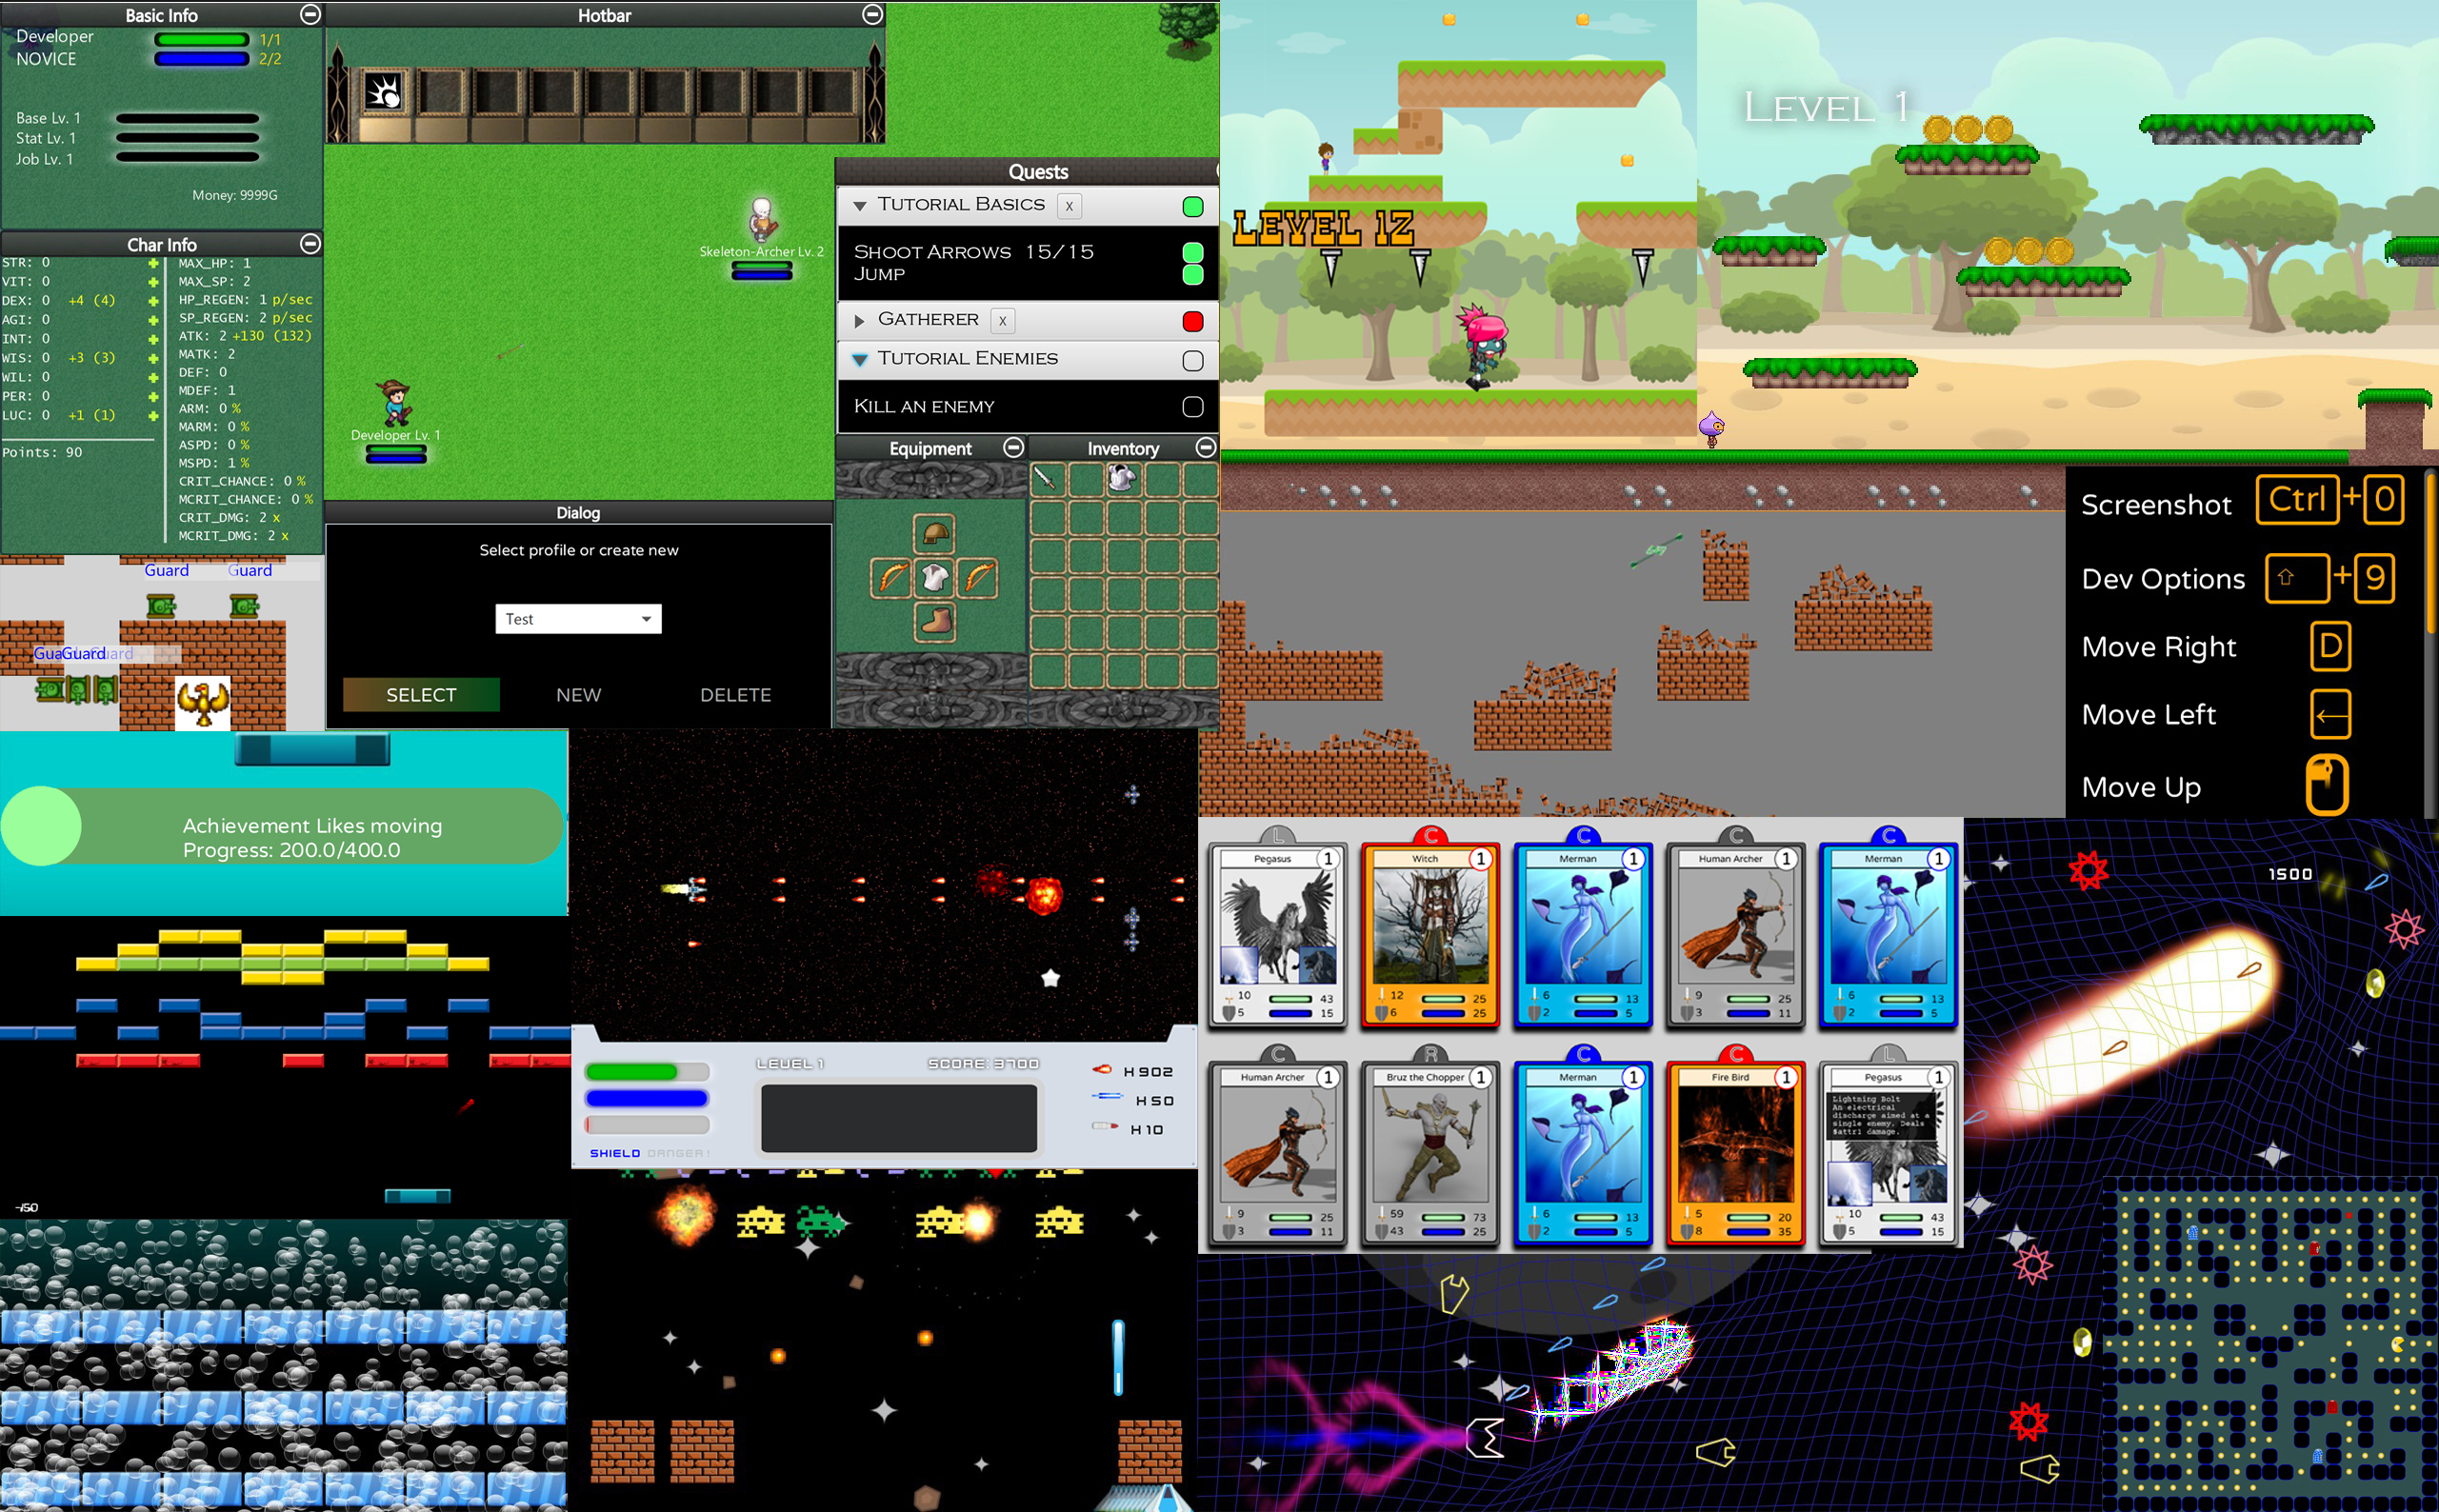
Community
FXGL by Almas Baimagambetov
https://github.com/AlmasB/FXGL
Notes:
Maybe add a drawing on the next slide, showing how enterprise apps and web frontends communicate

Slide 27
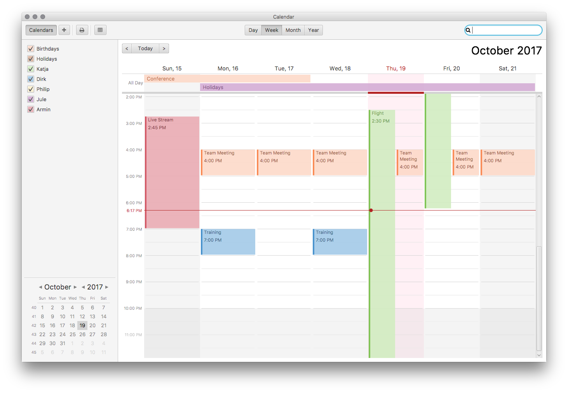
Community
CalendarFX by Dirk Lemmermann
https://github.com/dlsc-software-consulting-gmbh/CalendarFX
And many others…
Notes:
Maybe add a drawing on the next slide, showing how enterprise apps and web frontends communicate

Slide 28
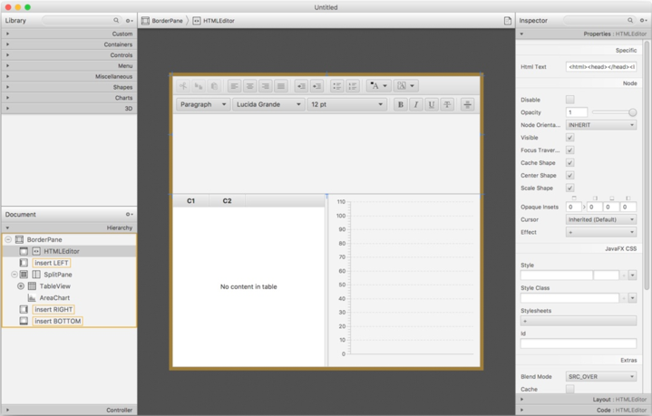
Tools
Scene Builder
http://gluonhq.com/products/scene-builder/
https://github.com/gluonhq/scenebuilder
SB 15.0.0 / 8.5.0
Notes:
Maybe add a drawing on the next slide, showing how enterprise apps and web frontends communicate

Slide 29
Scene Builder
Demo
Notes:
Maybe add a drawing on the next slide, showing how enterprise apps and web frontends communicate

Slide 30
Community driven: openjfx.io
Getting started with JavaFX
Basic info on how to run
Maven/gradle
IDE
Open!
Maintaining content takes time
No drive-by contributions

Slide 31
JavaFX and OpenJFX
JavaFX is a product name
OpenJFX is the project where JavaFX is developed
An OpenJDK project
Shares infrastructure, rules, issue tracker (JBS) with OpenJDK
Roles: author, committer, reviewer, project lead
Hosted on github
License: GPL + classpath exception
Notes:
Maybe add a drawing on the next slide, showing how enterprise apps and web frontends communicate

Slide 32
OpenJFX code on GitHub
Since JavaFX 11 (and recently with project Skara):
https://github.com/openjdk/jfx
Project Leads:
Oracle (Kevin Rushforth)
Gluon (Johan Vos)
Issues: JBS (http://bugs.openjdk.java.net/ )
PRs (OCA)
>20 contributors via GitHub in past year
most were first-time contributors
many made multiple contributions
Notes:
Maybe add a drawing on the next slide, showing how enterprise apps and web frontends communicate

Slide 33
OpenJFX binaries
Tagged builds created by Gluon
Accessible as SDK’s, jmods, maven artifacts
6 months release cadence (15, 16, 17,…)
3 types of builds:
Regular builds (e.g. JavaFX 15, JavaFX 15.0.1)
Early-access builds (e.g. JavaFX 16-ea+2)
LTS builds (e.g. JavaFX 11.0.8) (Gluon JavaFX 11 LTS customers only)
Notes:
Maybe add a drawing on the next slide, showing how enterprise apps and web frontends communicate

Slide 34
JavaFX Government
New features need effort and commitment by contributor:
Not simply proposing a change that your particular app would benefit from
We don’t want “drive-by” contributions
Think in terms of API “stewardship”
Inclusion of new features guided by OpenJFX project leads:
Kevin Rushforth (Oracle) and Johan Vos (Gluon)
Overarching goals for new features:
Consistency in the core APIs
Maintainability
Ability to implement on a wide range of platforms (including mobile devices)
Notes:
Maybe add a drawing on the next slide, showing how enterprise apps and web frontends communicate

Slide 35
Agenda
What is JavaFX
Using JavaFX in IntelliJ IDEA
JavaFX ecosystem and development
JavaFX structure/architecture

Slide 36
The stack
JavaFX apps
JavaFX Libraries etc
JavaFX Platform
This is where we are
Hardware/OS (desktop/mobile/embedded)

Slide 37
The JavaFX Platform
JavaFX API’s
JavaFX Platform
Internal implementation
Low-level rendering + window

Slide 38
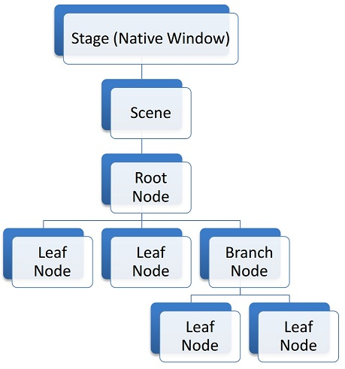
The JavaFX Platform
Scene graph based
Retained mode
Developer declares state, behavior, animations,…
JavaFX Rendering Pipeline deals with the rendering, isolated from the developer code
https://fxdocs.github.io/docs/html5/index.html

Slide 39
JavaFX Rendering
Separated from top-level API
100% cross-platform code
Platform-dependent optimization possible
Use hardware acceleration where possible
Fallback to software rendering
Pipelines for:
Desktop (Windows, Linux, MacOS)
Mobile (iOS, Android)
Embedded (Raspberry Pi, ARM32/64 bit, i.MX6, e-paper display,…)

Slide 40
Native apps
Appstore concept from mobile devices: bundle everything that is needed
Works on embedded and desktop as well
Biggest hurdle in the past: rely on users to update their JDK installation
Jlink/Java Packager fix this by bundling the JRE
We can go one step further, and compile AOT

Slide 41
How do we achieve this?
For optimal performance, use native code targeting the specific device
This is actually a requirement on iOS
How do we execute Java code as native code?
Compile the Java bytecode ahead of time to native code
Compile the native code (e.g. libnet.so, libprism_es2.so) for the specific target
GraalVM native-image allows this
Still needs to be combined with native Java/JavaFX code
Requires Java static libs for the target
OpenJDK Mobile

Slide 42
Gluon Substrate: from Java(FX) to apps
Java Application
Gluon Substrate
(And Client plugins)
Runs on Win/Linux/Mac
Native image for desktop
Dependencies (via Maven/Gradle)
Native image for mobile/embedded
Java SDK
OpenJDK
mobile build
JavaFX SDK
OpenJFX
mobile build
Gluon Mobile
Mobile UI
Device access
GraalVM
Native-image
AOT

Slide 43
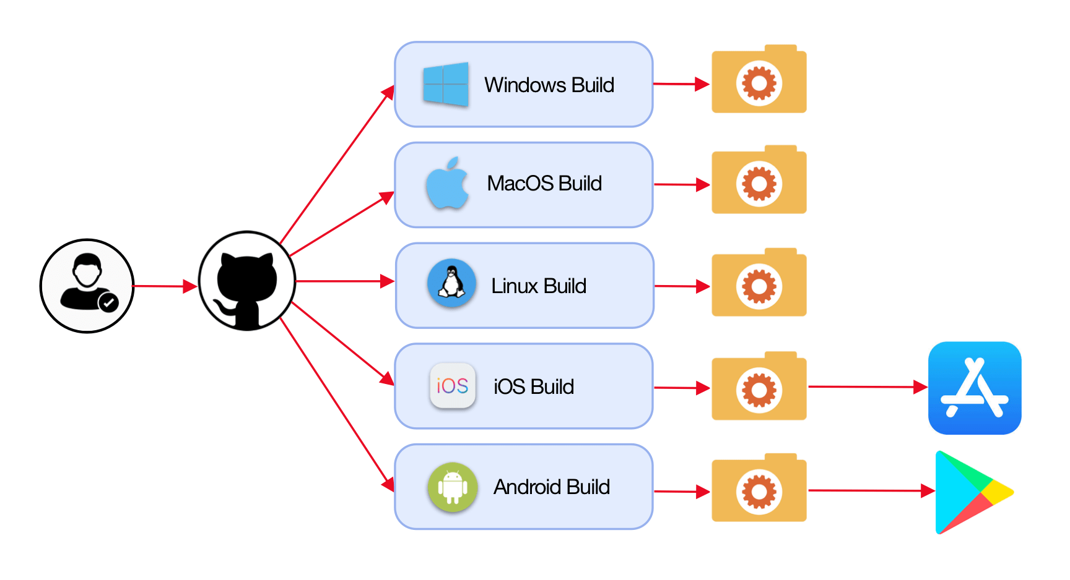
Automation with Github actions

Slide 44
Summary: JavaFX
Provides the UI platform for Java
Leverages the benefits from Java
Allows deployment of Java (UI) applications on desktop, mobile and embedded devices
Has a large ecosystem
Is developed in an open development model
Allows to create native applications on desktop, mobile and embedded devices

Slide 45
Thanks For Attending
Any Questions?
Johan Vos, @johanvos
Gluon, https://gluonhq.com

